Slide 1
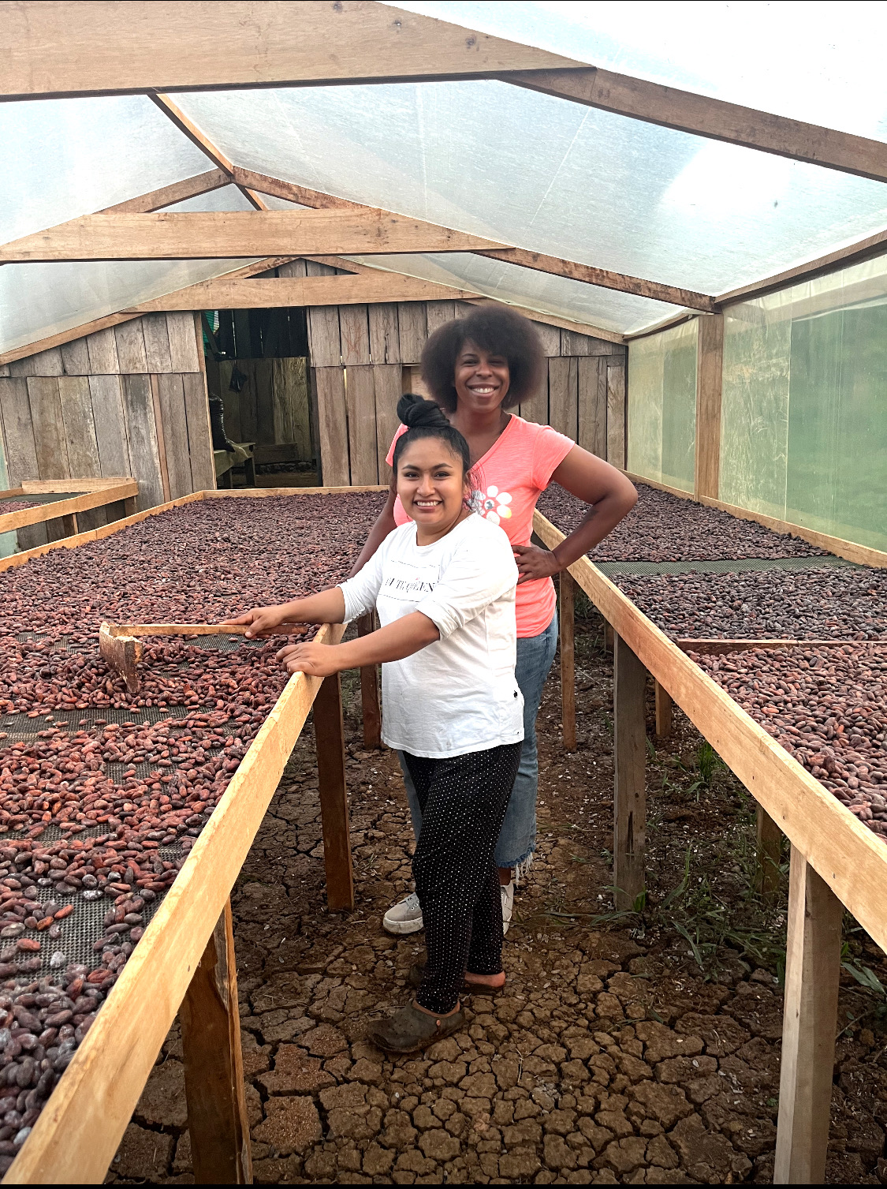
WOMEN AT THE HEART OF
SUSTAINABLE FOOD SYSTEMS
From participation to power, ownership and agency
Mercedes Diane Griffin Forbes
Forbes Food & Ag • DG Speaks
Greenfest Braga • 26 September 2026
Notes:
[object Object],[object Object],[object Object]

Slide 2
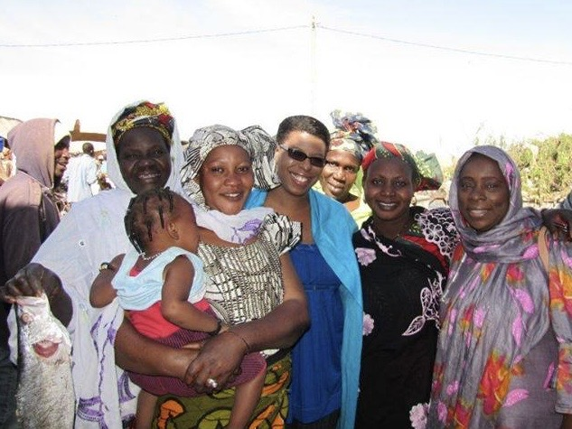
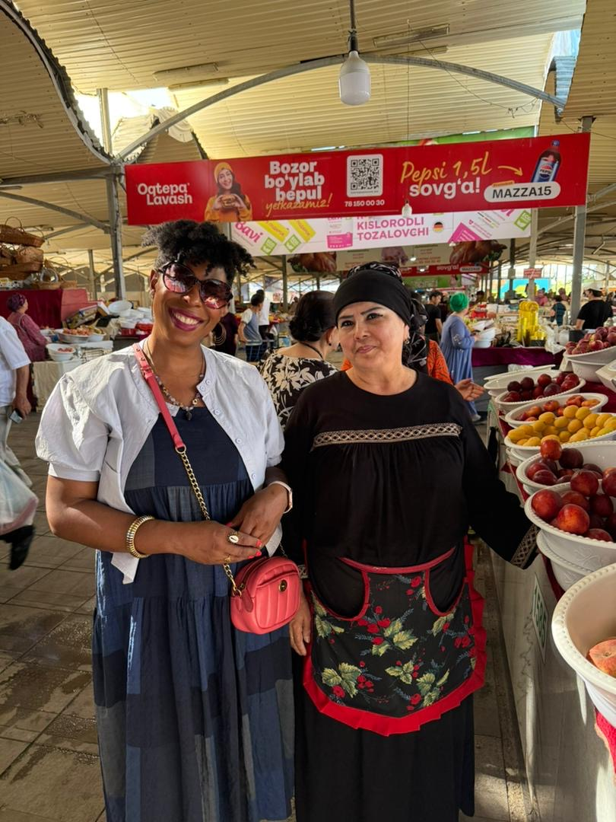
ACROSS FOOD SYSTEMS
I kept seeing the same pattern
Women were producing, selling, feeding, organizing and adapting.
Notes:
[object Object],[object Object]

Slide 3
THE CENTRAL ARGUMENT
Participation is not the same as power
LABOR
ASSETS
MARKETS
VOICE
Who does the work?
Who owns land, tools and capital?
Who reaches buyers and captures value?
Who shapes decisions and policy?
A sustainable food system needs women not only inside the system, but able to shape it.
Notes:
[object Object],[object Object]

Slide 4
WHAT THE EVIDENCE TELLS US
The scale is enormous
36%
24%
82¢
of working women globally are employed in agrifood systems
land-productivity gap between female- and male-managed farms of the same size
earned by women for every $1 earned by men in agricultural wage employment
These gaps are not about women’s ability. They reflect unequal access to resources, services, markets and decision-making.
Source: FAO, The Status of Women in Agrifood Systems (2023)
Notes:
[object Object],[object Object],[object Object]

Slide 5
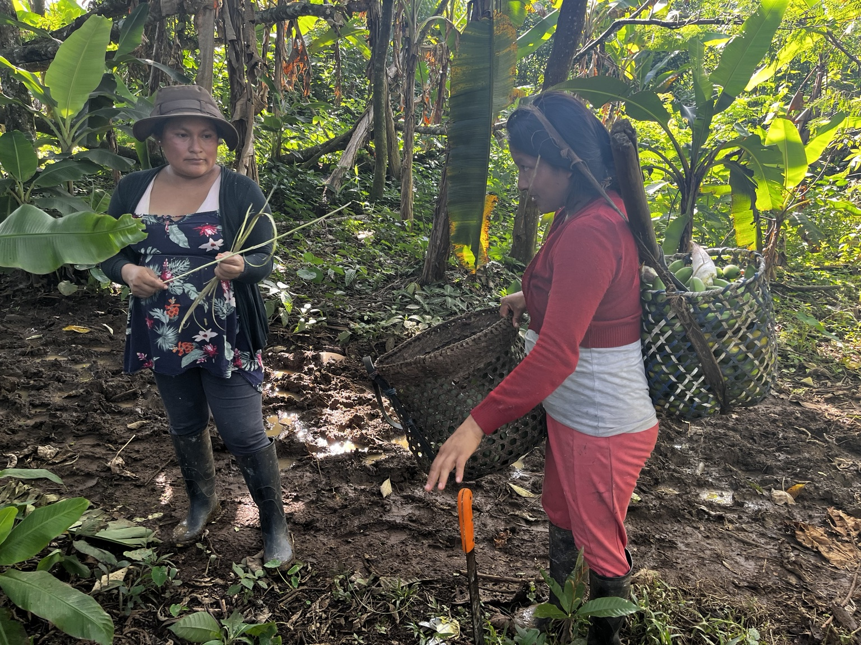
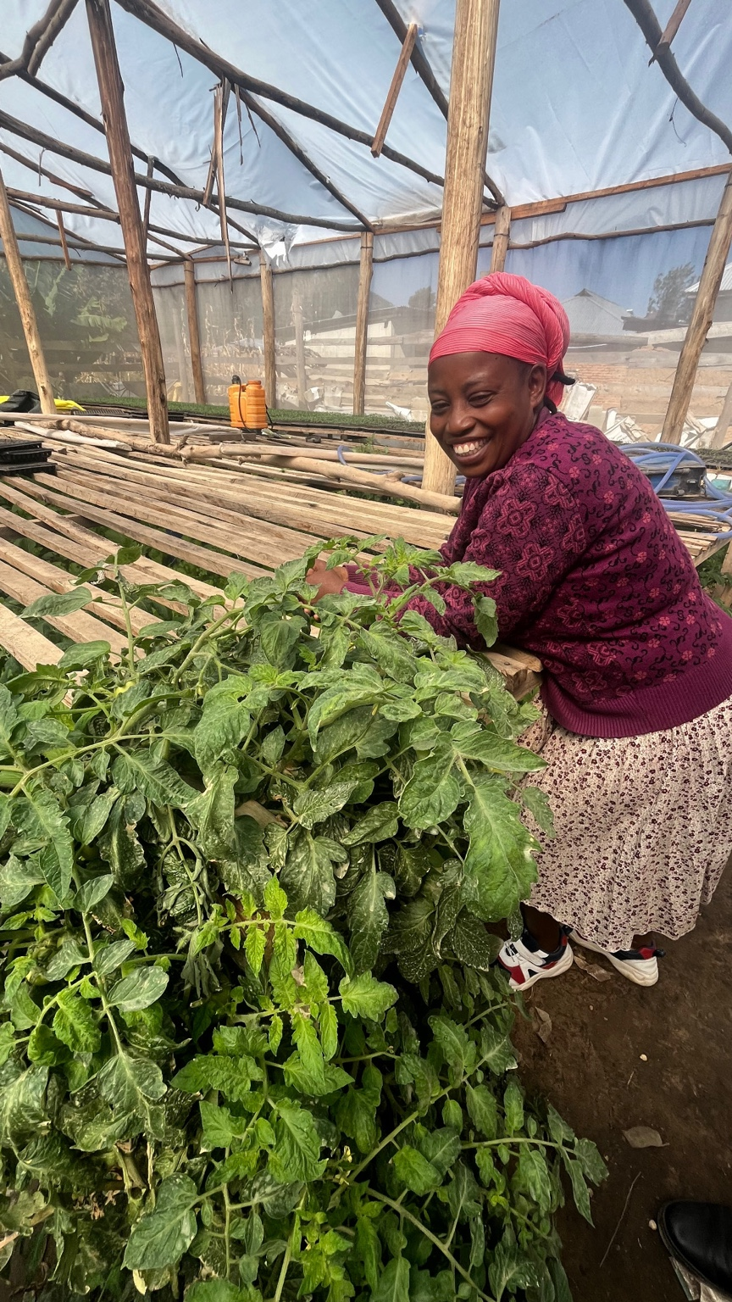
LAND • FINANCE • TECHNOLOGY • KNOWLEDGE
Access changes what is possible
LAND & TENURE
FINANCE
TECHNOLOGY
EXTENSION & TRAINING
TIME
Notes:
[object Object],[object Object]

Slide 6
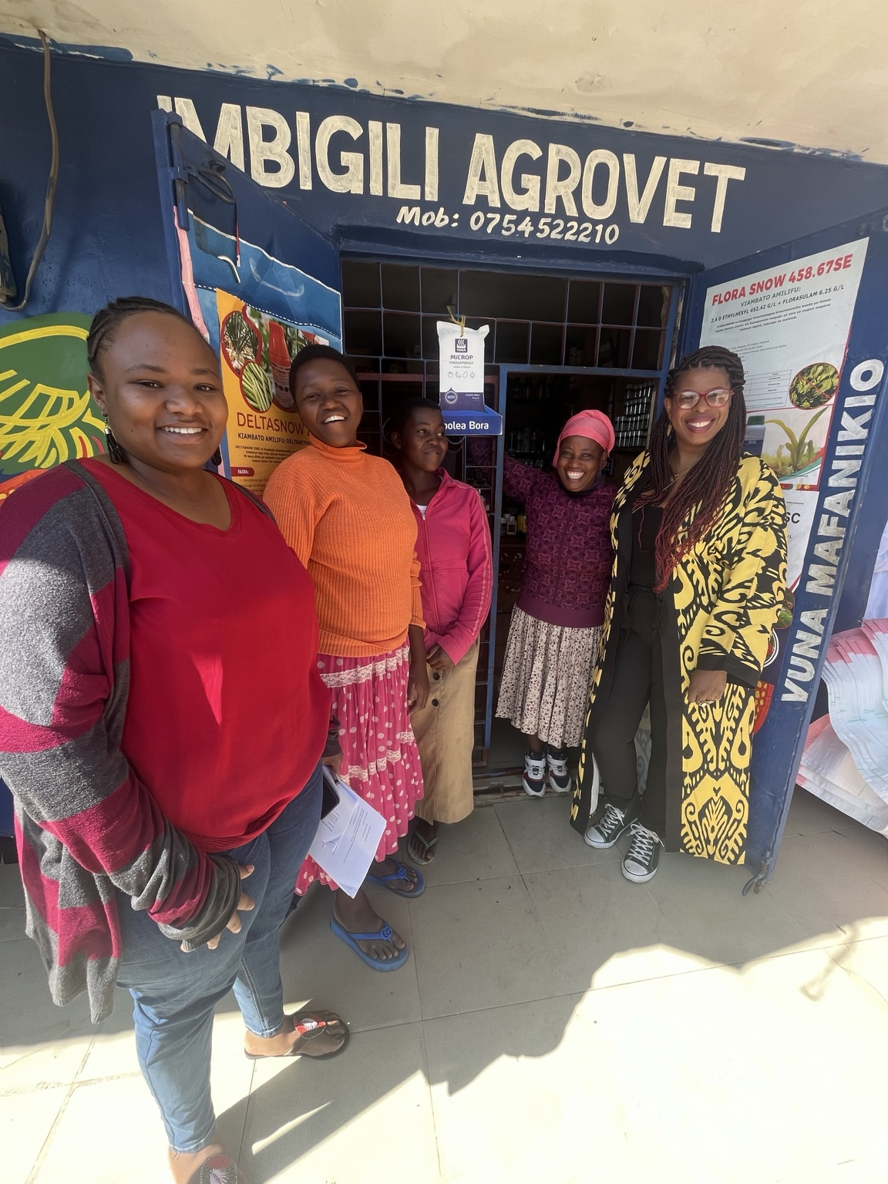
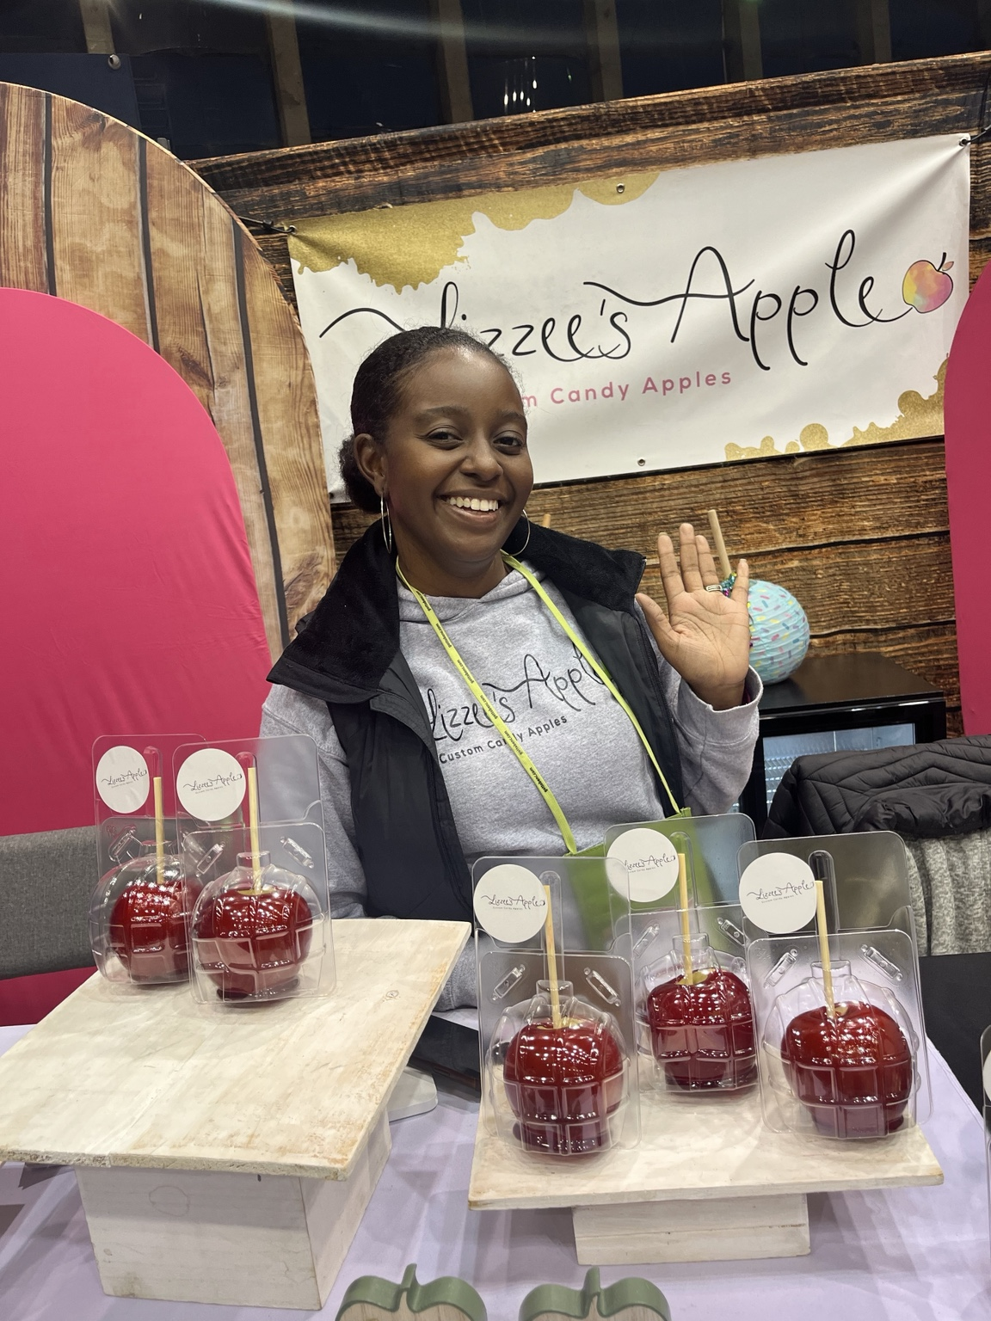
BEYOND PRODUCTION
Markets are where value becomes power
SELL
OWN
ADD VALUE
Notes:
[object Object],[object Object]

Slide 7
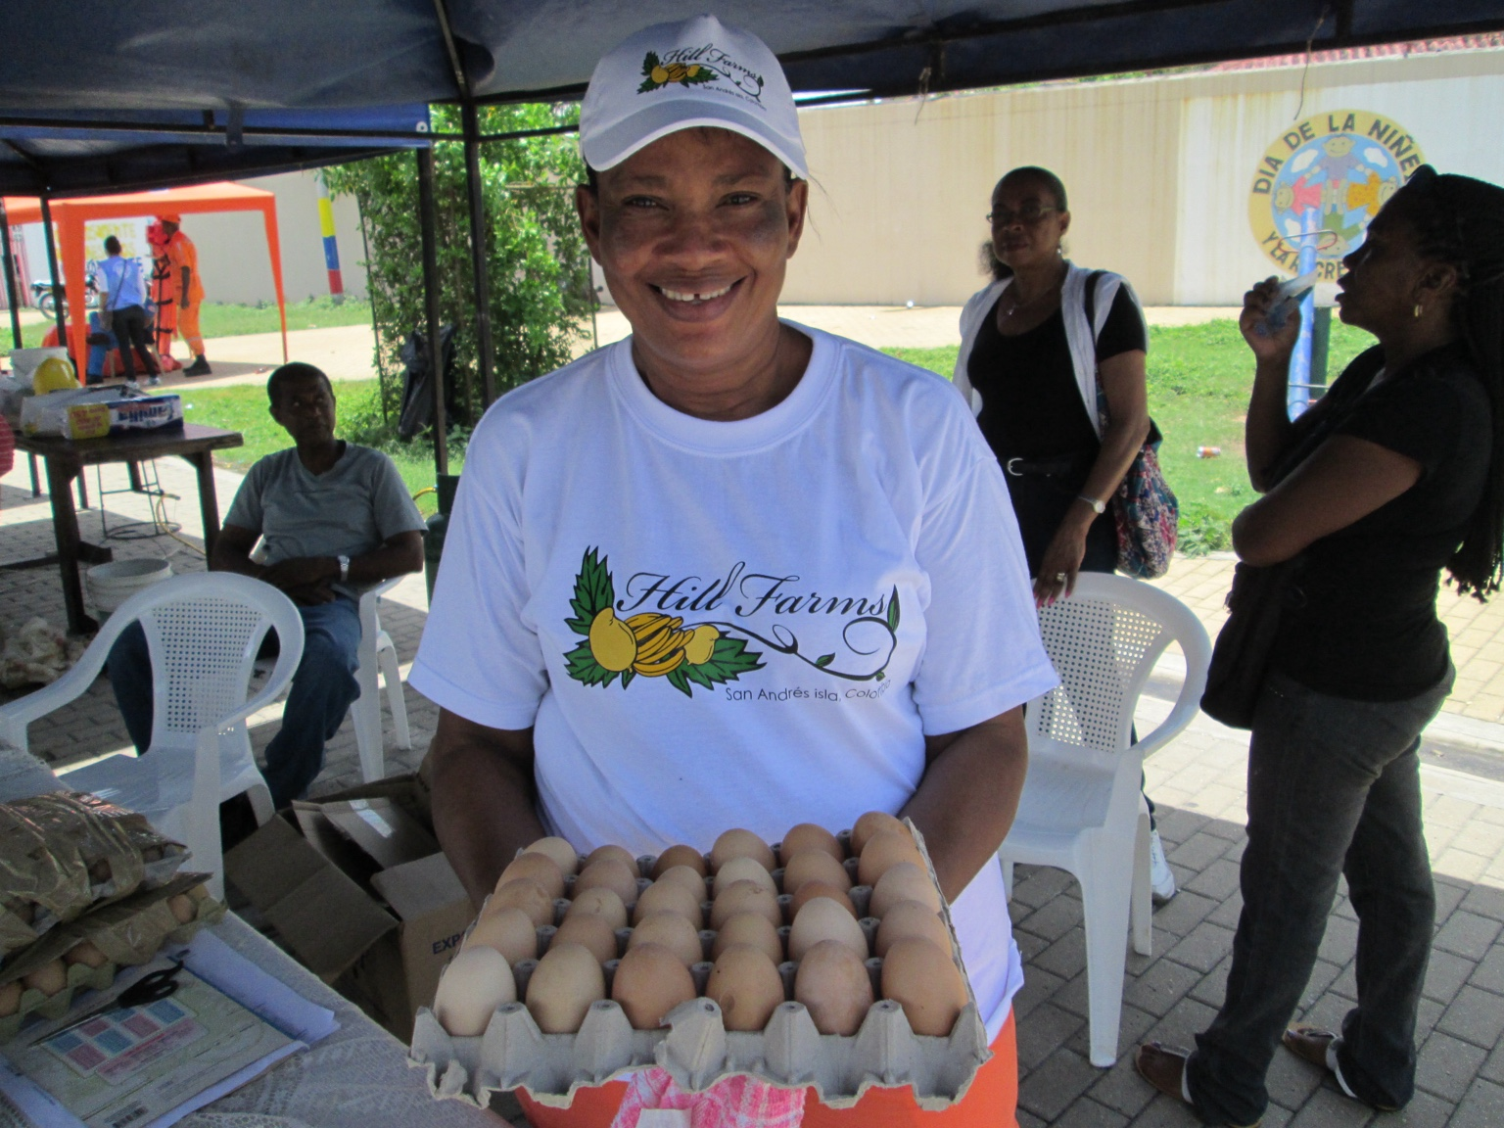
ENTERPRISE AND AGENCY
Ownership changes the conversation
When women control assets and enterprises, they negotiate from a different position.
Notes:
[object Object],[object Object]

Slide 8
EQUALITY STRENGTHENS FOOD SYSTEMS
The payoff is systemic
≈ $1 TRILLION
45 MILLION
potential increase in global GDP from closing farm productivity and agricultural wage gaps
fewer people facing food insecurity
Gender equality is not a side project. It is part of the infrastructure of a resilient food system.
Source: FAO, The Status of Women in Agrifood Systems (2023)
Notes:
[object Object],[object Object]

Slide 9
MOVE FROM INCLUSION TO AGENCY
What transformation looks like
Design WITH women
→
Not for women
Finance ownership
→
Not only participation
Measure control and voice
→
Not only headcounts
Build market power
→
Not only production skills
Change institutions
→
Not only individual behavior
Notes:
[object Object],[object Object]

Slide 10
A SIMPLE TEST FOR EVERY INTERVENTION
Ask a different question
WHO…
owns the asset?
controls the income?
has access to the market?
sets the priorities?
can say no?
gets to decide what happens next?
If we cannot answer these questions, we have not yet measured empowerment.
Notes:
[object Object],[object Object]

Slide 11
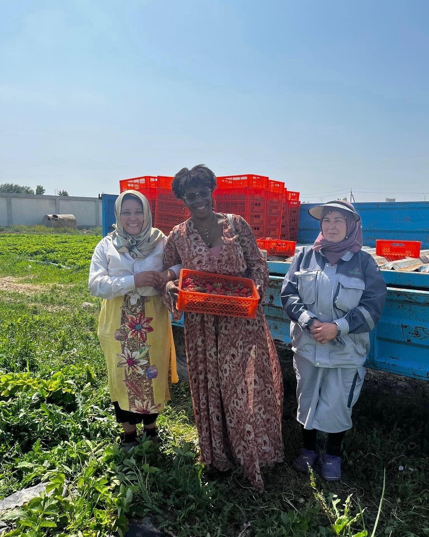
Women are not simply beneficiaries of sustainable food systems.
They are architects of them.
The task is to make sure they have the power, resources and authority to build.
Thank you
Mercedes Diane Griffin Forbes • Forbes Food & Ag • DG Speaks
Notes:
[object Object],[object Object],[object Object]

